Slide 1

Predicting the Persistency of a Drug (Healthcare)
EDA Presentation
Data Science Internship
Name: Harshith Sakala Santhosh
Internship Batch: LISUM-19
Group Name :Gold Standard Team

Slide 2
Summary of Dataset
Number of Registers: 3424
Number of Features: 69
Distribution of target classes.
46 out of 66 categorical variables presents significant correlation with the target.
Top 10 predictors with higher correlation significance with the target:
Dexa_During_Rx
Comorb_Long_Term_Current_Drug_Therapy
Comorb_Encounter_For_Screening_For_Malignant_Neoplasms
Comorb_Encounter_For_Immunization
Comorb_Encntr_For_General_Exam_W_O_Complaint,_Susp_Or_Reprtd_Dx
Comorb_Other_Disorders_Of_Bone_Density_And_Structure
Concom_Systemic_Corticosteroids_Plain
Comorb_Other_Joint_Disorder_Not_Elsewhere_Classified
Concom_Anaesthetics_General
Concom_Viral_Vaccines

Slide 3
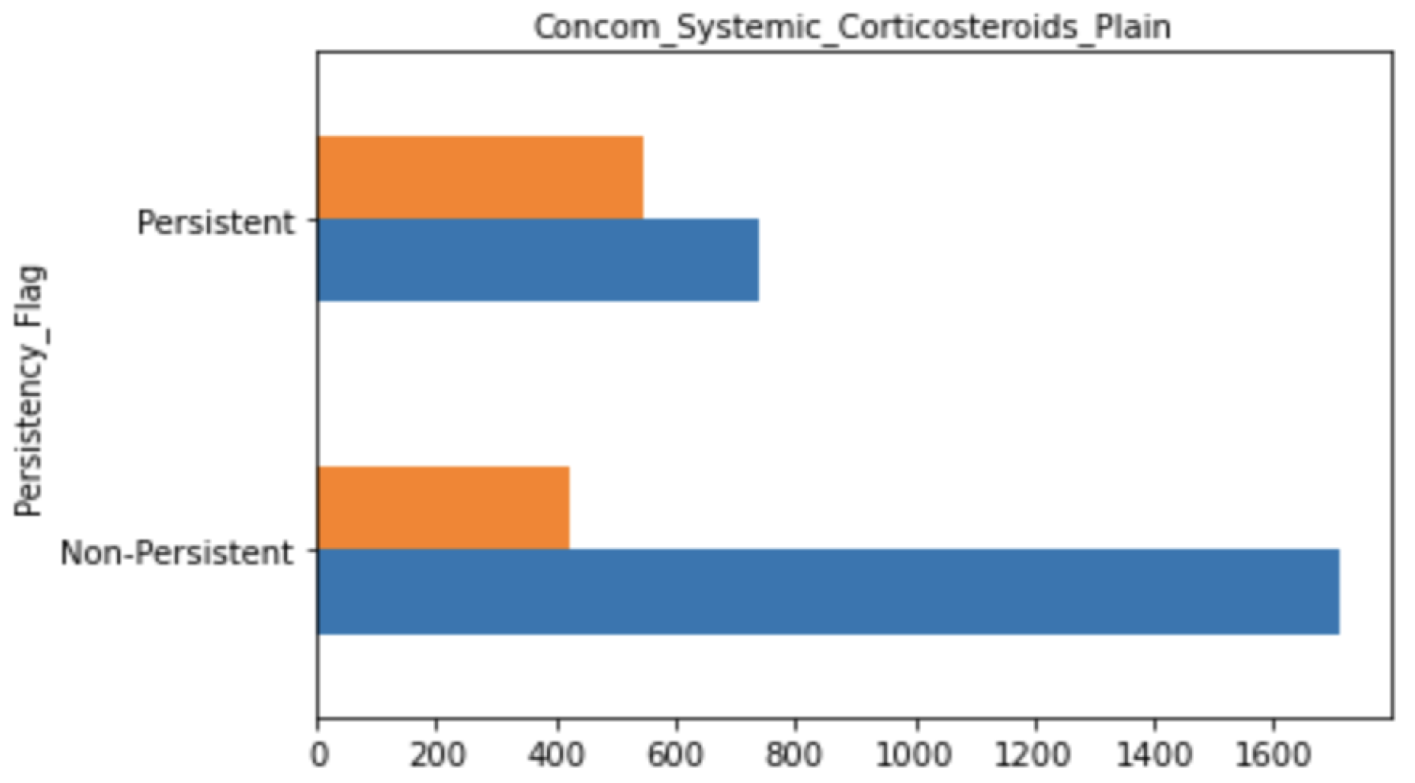
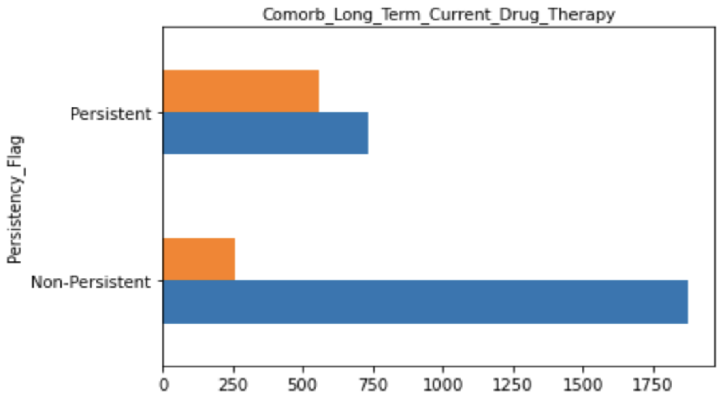
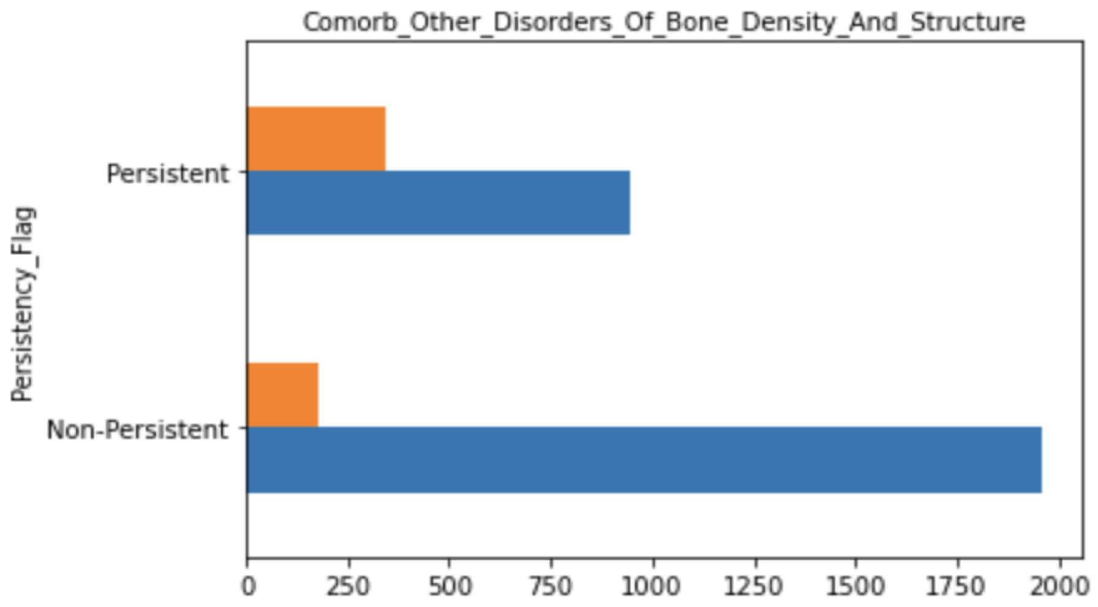
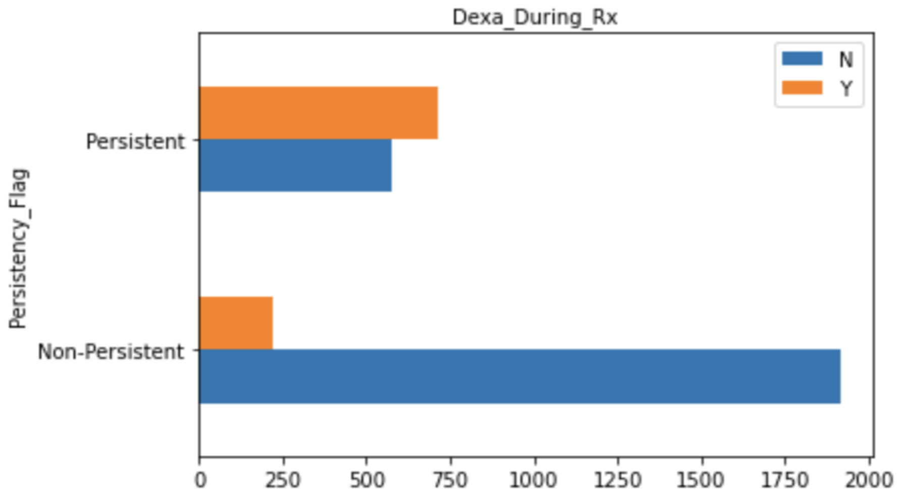
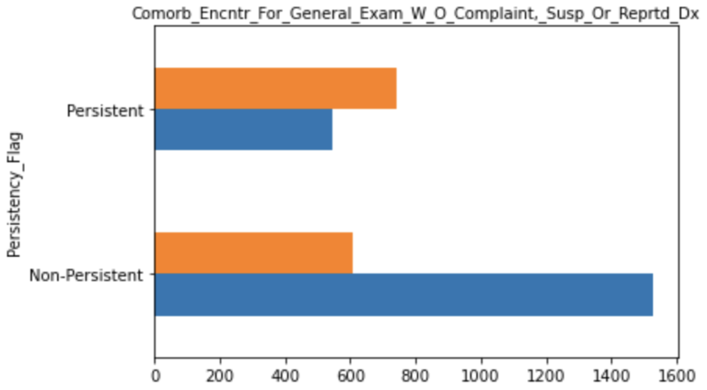
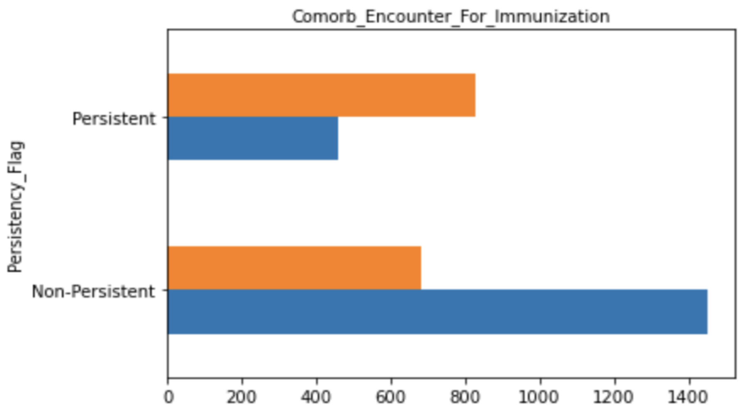
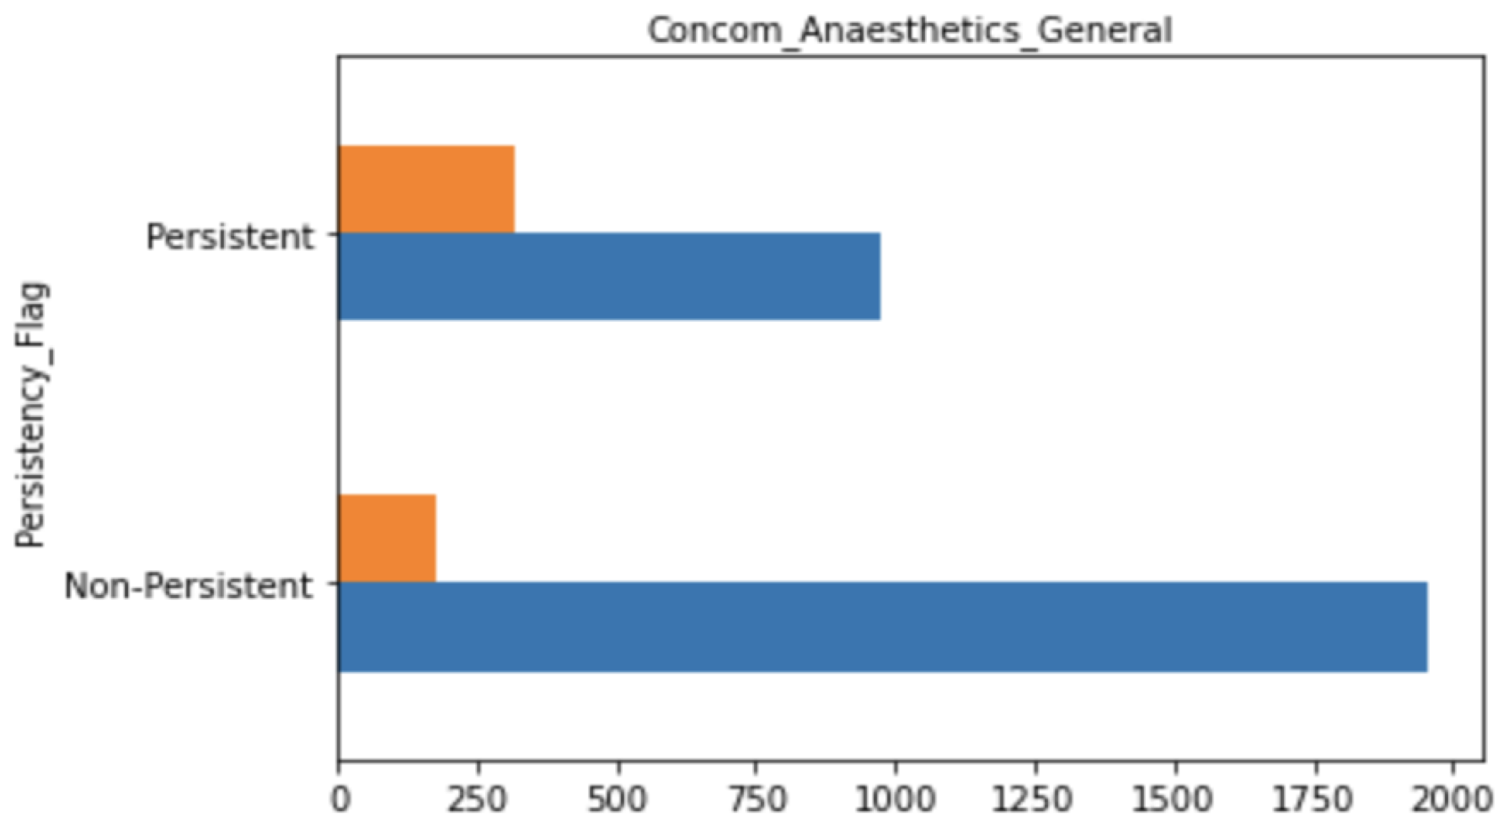
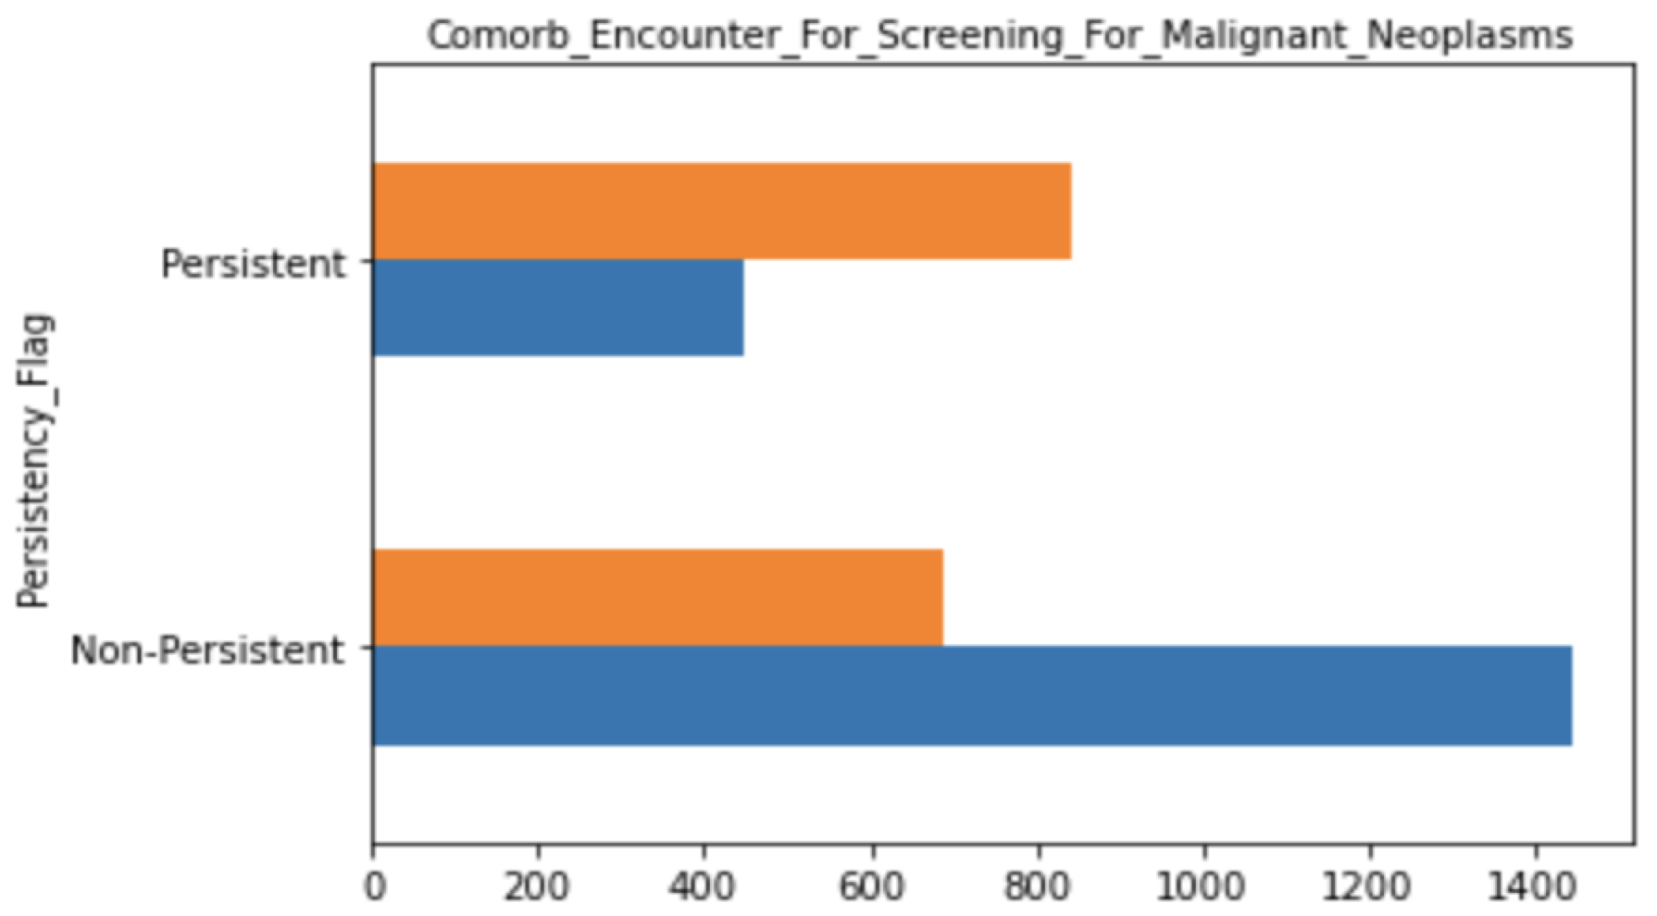
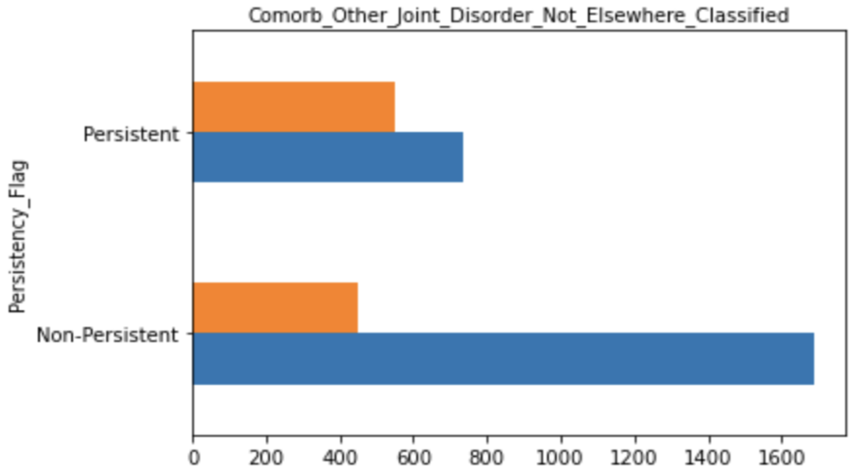
Most Important Categorical Variables

Slide 4
Categorical Variables
Most of patients that were receiving Dexa during Rx were persistent to the new drug, whereas most patients that were not receiving Dexa during Rx were classified as non-persistent.
A similar behavior was observed for the variables Comorb_Encounter_For_Screening_For_Malignant_Neoplasms, Comorb_Encounter_For_Immunization, and Comorb_Encntr_For_General_Exam_W_O_Complaint,_Susp_Or_Reprtd_Dx.
The other 5 variables, including Comorb_Long_Term_Current_Drug_Therapy, Comorb_Other_Disorders_Of_Bone_Density _And_Structure, Concom_Systemic_Corticosteroids_Plain, Comorb_Other_Joint_Disorder_Not_Elsewhere_Classified, Concom_Anaesthetics_General, presented higher number of negative values compared to positive (‘yes’) for both target classes, however in a higher proportion for the non-persistent patients.
NTM_Speciality Variables
All the Ntm_Speciality variables were correlated to each other, of which the Ntm_Specialist_Flag seems to better represent this category of variables in a simpler manner with only 2 categories. Similar correlation was observed for many other pairs of variables.

Slide 5
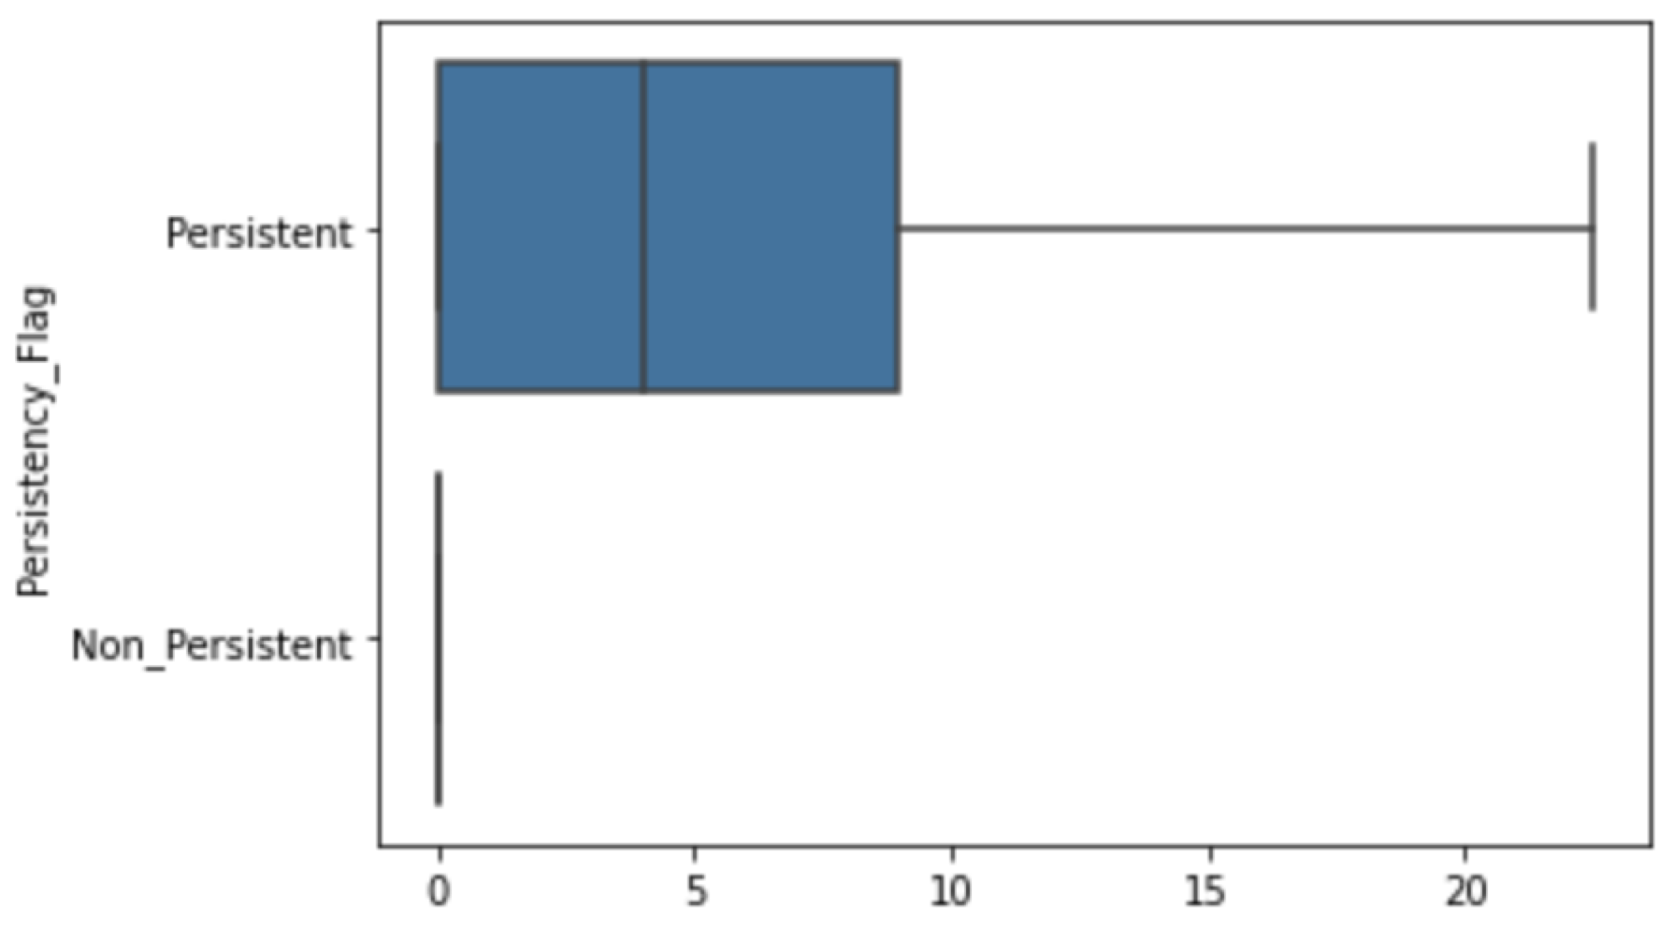
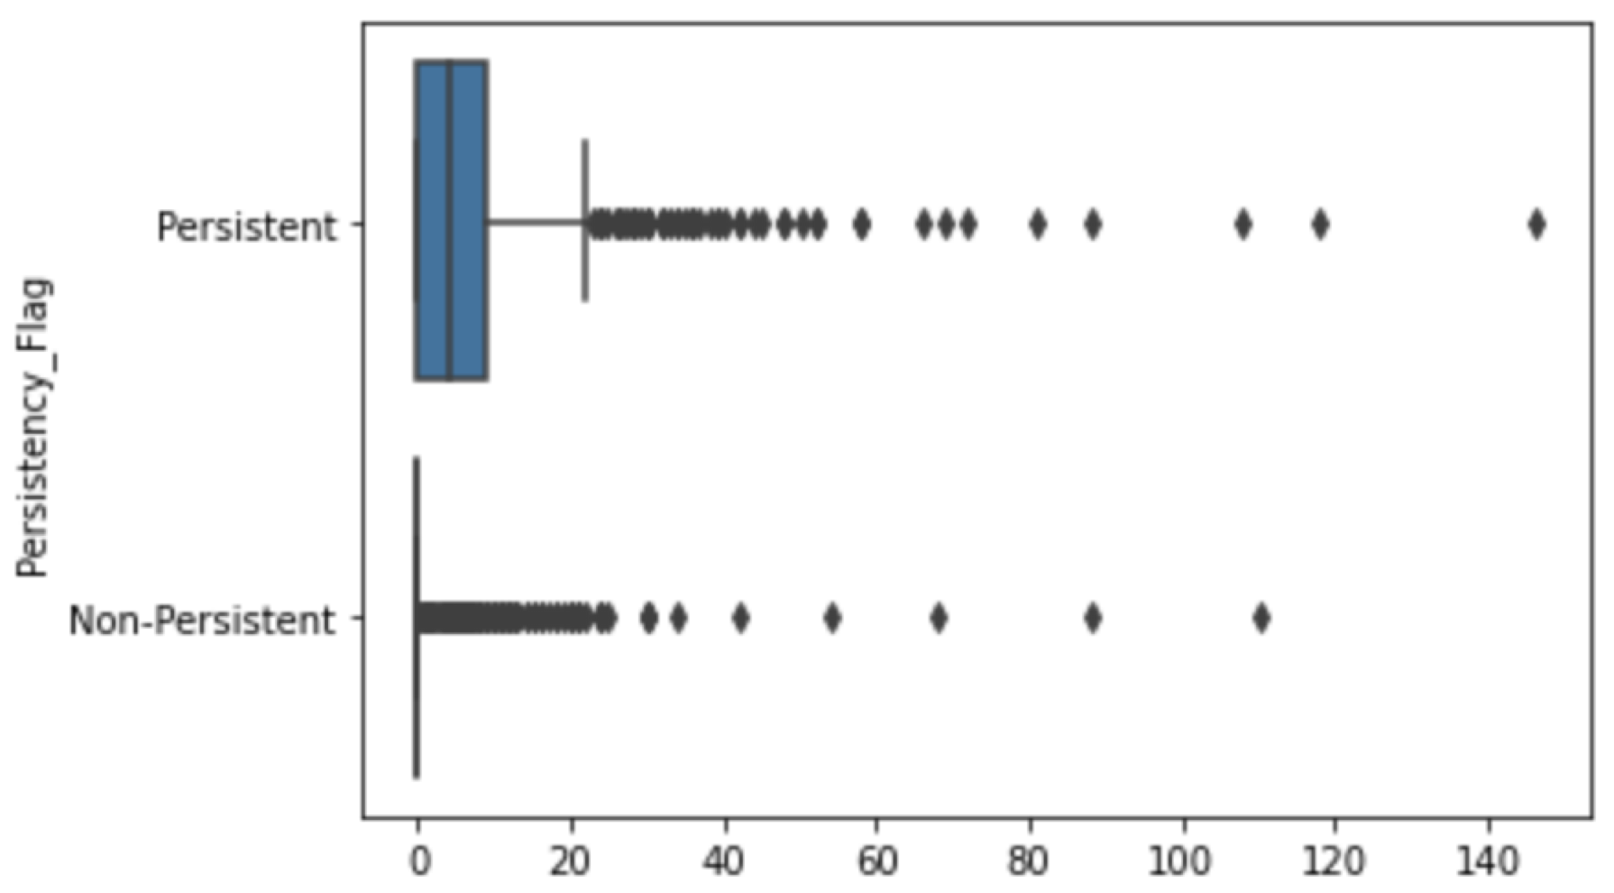
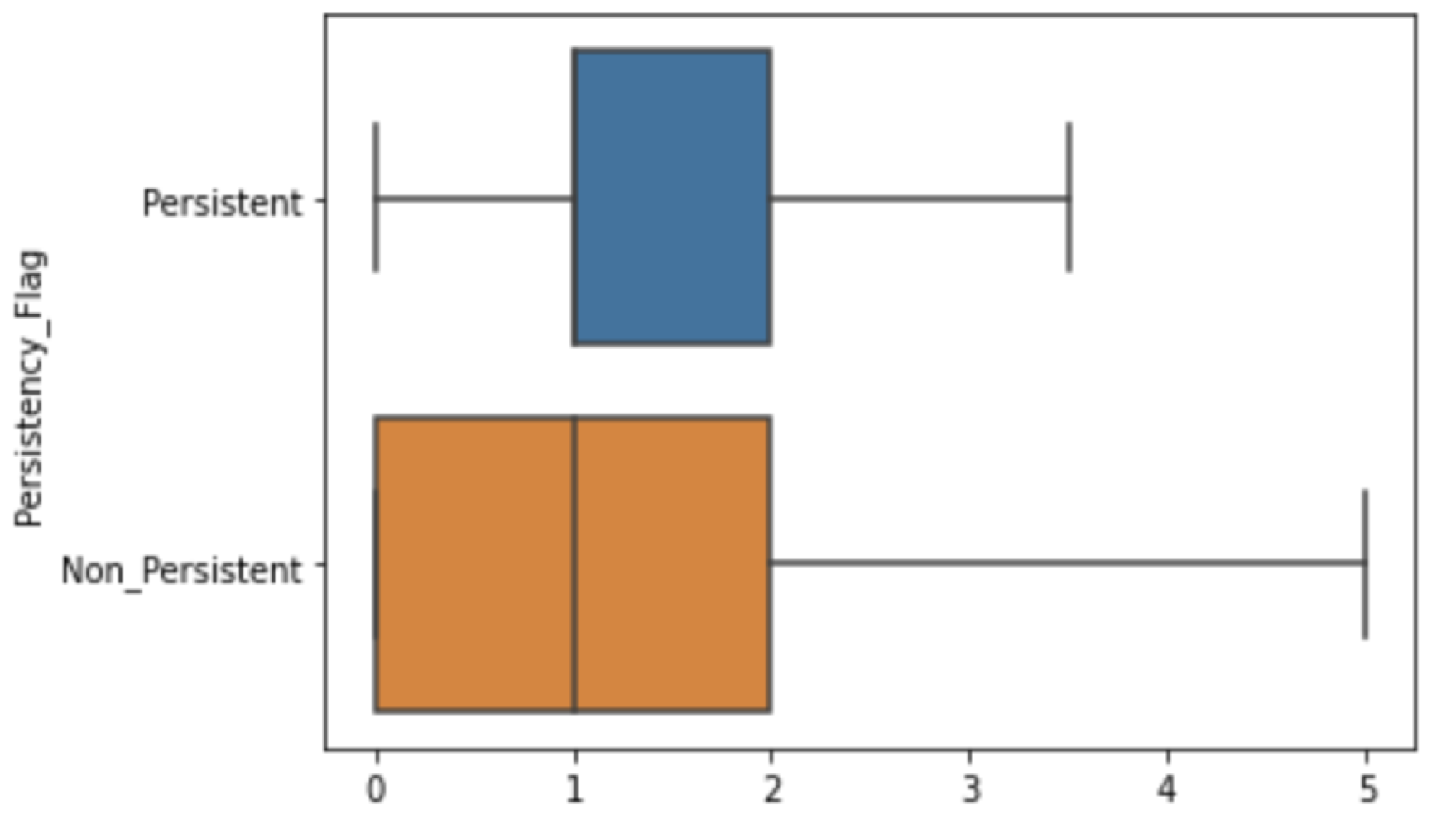
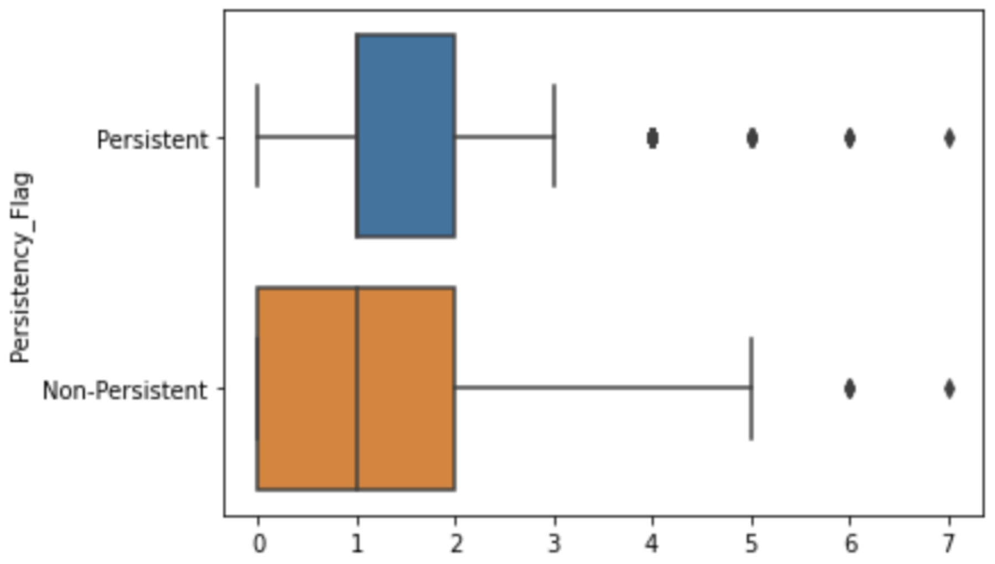
Numerical Variables
Dexa_Freq_During_Rx and Count_Of_Risks
 | Dataset Before Transformation | Dataset After Transformation (approach 2)
Dexa_Freq_During_Rx
Count_Of_Risks

Slide 6
Numerical Variables
Correlation of Dexa_Freq_During_Rx and Dexa_During_Rx
Correlation (t-test) of Target with Dexa_Freq_During_Rx
p-value = 1.054 e-90

Slide 7
Numerical Variables
Correlation of Count_Of_Risks and other Risk Related Variables
With exception to the variables Risk_Osteogenesis_Imperfecta and Risk_Untreated_Chronic_Hyperthyroidism (figure below), all the other risk-related variables presented a significant correlation with the Count_Of_Risks. However, these variables are correlated with other risk-related variables.

Slide 8
Recommendations
There is a strong correlation between most of the variables and the target variables, however a considerable number of predictors are correlated. A definitive list of variables to be used will only be precisely defined during the feature selection and modeling steps, where different group of variables will be tested.
The numerical variables may not be used in the modeling steps because they are correlated with other categorical predictors.
Features will be selected based on the correlation, but a technique for dimensionality reduction to diminish the number of variables will also be tested.
At least three algorithms will be tested to create the model with highest performance, and these include the Random Forest, Support Vector Machines (SVM) and Adaboost.

